Slide 1

Advanced Web-Based CPU and Cache Memory Simulator
CSA-1220 – Computer Architecture
Presented by:
SANJAY KUMAR P(1925565073)
SHALK YUNUS (192525256)
G LOKESH YADAV(192411061)
GUIDED BY: Dr. RADHIKA S

Slide 2


ABSTRACT
Develop a web-based simulator to visualize CPU execution and cache memory operations interactively.
Simulate CPU pipeline stages (Fetch, Decode, Execute, Memory, Write Back) with real-time animations.
Implement cache memory algorithms such as FIFO and LRU to analyze cache hit and miss performance.
Provide an easy-to-use learning platform that enhances understanding of Computer Architecture concepts through graphical visualization.

Slide 3
INTRODUCTION
Computer Architecture explains how processors execute instructions and manage memory efficiently.
CPU pipeline and cache memory are fundamental concepts that improve system performance but are difficult to visualize.
A web-based simulator allows students to observe processor operations directly through an interactive interface.
This project combines CPU pipeline simulation and cache memory analysis into a single browser-based educational platform.

Slide 4
PROBLEM STATEMENT & MOTIVATION
Existing CPU simulators are often complex, desktop-based, and difficult for beginners to understand.
Students face challenges in learning CPU pipeline execution and cache memory behavior using traditional methods.
There is a need for an interactive web application that clearly demonstrates processor and cache operations.
The proposed simulator aims to improve learning by providing real-time visualization, performance analysis, and easy accessibility through a web browser.

Slide 5


LITERATURE SURVEY
Author | Year | Paper Title | Tools / Technologies | Research Gap
Hwang et al. | 2025 | Survey of CPU and Memory Simulators in Computer Architecture | gem5, CPU simulators, compiler integration | Mostly research-oriented; lacks beginner-friendly web visualization.
Jaros et al. | 2024 | Web-Based Simulator of Superscalar RISC-V Processors | Web GUI, RISC-V, JavaScript | Focuses only on RISC-V processors with limited cache visualization.
Liu et al. | 2025 | CacheSim: A Cache Simulation Framework | C++, Python, CacheSim | Designed for cache evaluation rather than interactive educational learning.
Lee et al. | 2024 | Gem5-AVX: Extension of the Gem5 Simulator | gem5, AVX, x86 architecture | Supports advanced processor simulation but requires significant setup and expertise.

Slide 6
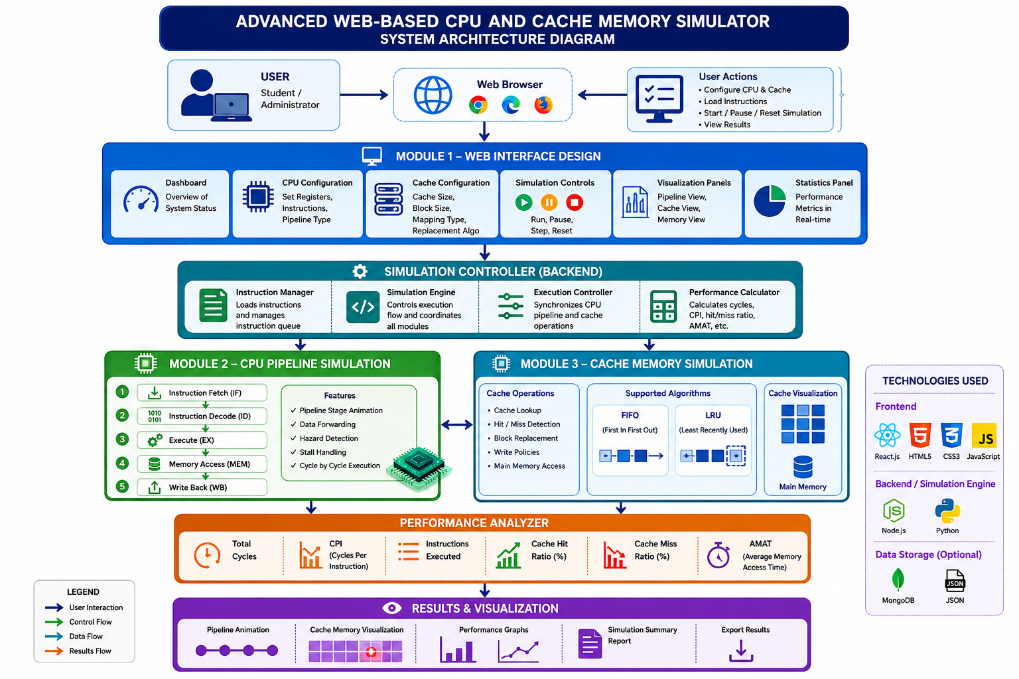
SYSTEM ARCHITECTURE

Slide 7
MODULE 1 – WEB INTERFACE DESIGN
Objective
Develop an attractive and interactive web interface for CPU and cache simulation.
Methodology
Design responsive web pages.
Provide processor configuration options.
Display instruction execution graphically.
Present cache statistics dynamically.
Proposed Implementation
Frontend:
HTML5
CSS3
JavaScript
React.js
Features:
Dashboard
Pipeline visualization
Cache visualization
Statistics panel
Control buttons
Expected Outcome
User-friendly interface
Easy navigation
Interactive processor visualization
Better learning experience

Slide 8
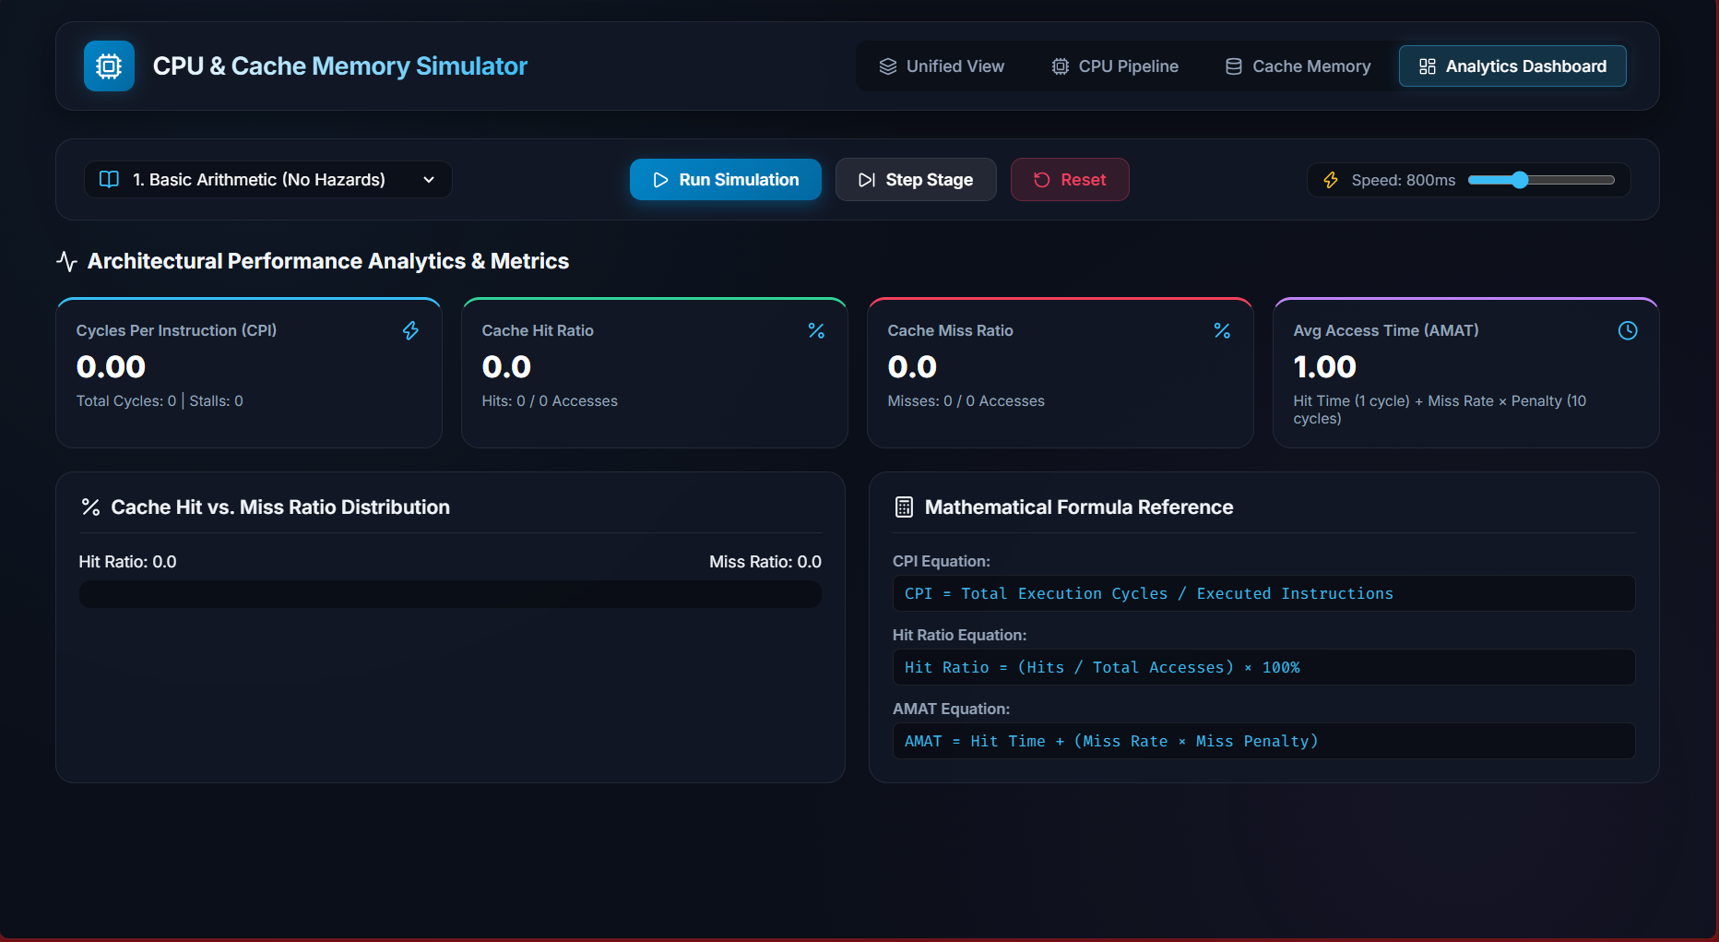
OUTPUT

Slide 9
MODULE 2 – CPU PIPELINE SIMULATION
Objective
Simulate instruction execution through CPU pipeline stages.
Methodology
The simulator processes instructions sequentially through:
Instruction Fetch
Instruction Decode
Execute
Memory Access
Write Back
Pipeline execution is animated with timing information.
Proposed Implementation
Backend:
JavaScript simulation engine
Instruction queue
Pipeline registers
Execution controller
Performance Metrics:
CPI
Pipeline utilization
Execution cycles
Expected Outcome
Visual CPU execution
Pipeline analysis
Better understanding of instruction flow
Performance comparison

Slide 10
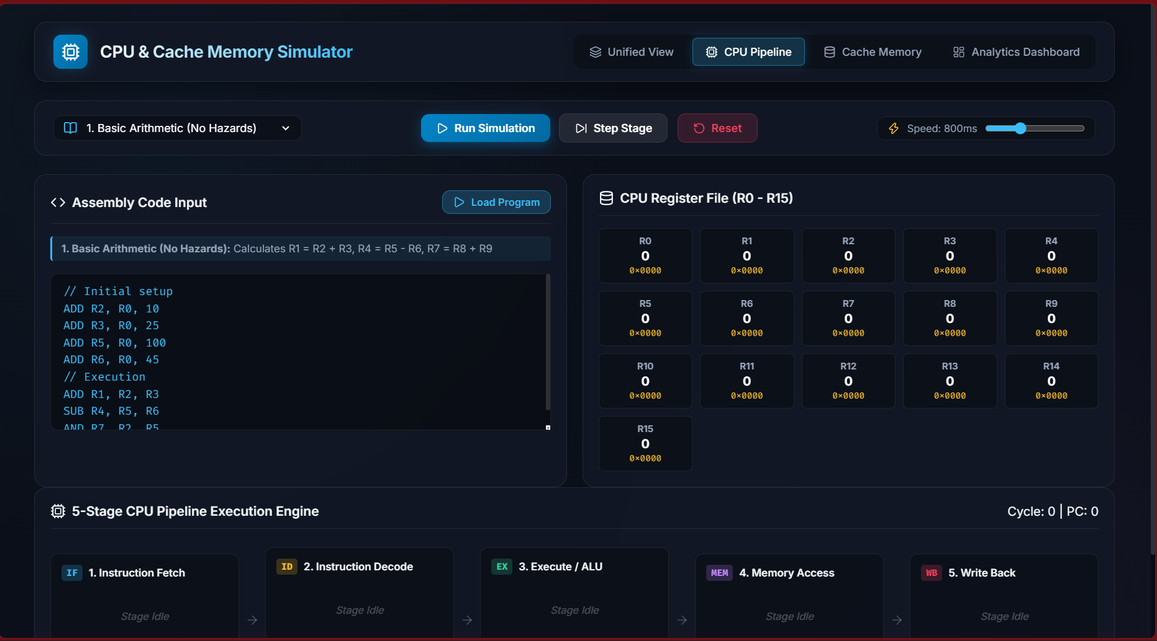
OUTPUT

Slide 11
MODULE 3 – CACHE MEMORY SIMULATION
Objective
Simulate cache memory behavior and replacement algorithms.
Methodology
The simulator accepts memory references and performs:
Cache lookup
Hit detection
Miss detection
Replacement algorithm execution
Performance calculation
Algorithms:
FIFO
LRU
Proposed Implementation
Features:
Cache blocks
Main memory representation
Cache visualization
Hit/Miss animation
Performance statistics
Metrics:
Cache Hit Ratio
Miss Ratio
Access Time
Expected Outcome
Clear understanding of cache operation
Comparison of replacement algorithms
Performance analysis
Interactive visualization

Slide 12
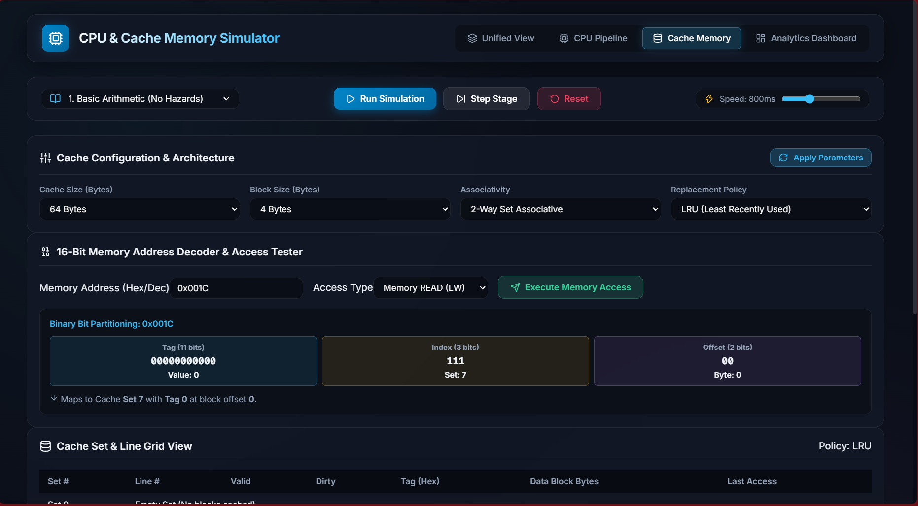
OUTPUT

Slide 13
CONCLUSION
The proposed Advanced Web-Based CPU and Cache Memory Simulator provides an effective educational platform for understanding processor architecture concepts.
Through interactive visualizations, CPU pipeline simulation, cache memory analysis, and performance evaluation, users gain practical knowledge of processor operations.
The browser-based design enhances accessibility and simplifies learning without requiring specialized software installations.

Slide 14
FUTURE WORK
Multi-core CPU simulation
Branch prediction visualization
Virtual memory simulation
Advanced cache replacement algorithms (LFU, ARC)
Performance benchmarking
RISC-V instruction support
ARM architecture support
AI-assisted performance optimization

Slide 15
REFERENCES
Hwang, I., Lee, J., Kang, H., Lee, G., & Kim, H. A. (2025). Survey of CPU and memory simulators in computer architecture: A comprehensive analysis including compiler integration and emerging technology applications. Simulation Modelling Practice and Theory, 138, 103032. https://doi.org/10.1016/j.simpat.2024.103032
Liu, J., Chen, Y., & Ding, H. (2025). CacheSim: A cache simulation framework for evaluating caching algorithms on resource-constrained edge devices. SoftwareX, 29, 102018. https://doi.org/10.1016/j.softx.2024.102018
Lee, S., Kim, Y., Nam, D., & Kim, J. (2024). Gem5-AVX: Extension of the gem5 simulator to support AVX instruction sets. IEEE Access, 12, 20767–20778. https://doi.org/10.1109/ACCESS.2024.3359296
Jaros, J., Majer, M., Horky, J., & Vavra, J. (2024). Web-Based Simulator of Superscalar RISC-V Processors. IEEE/SC Workshop Proceedings.

Slide 16
THANK YOU

